Slide 1
First order logic
Session 08
Henry Lucky, S.Kom., M.Kom.

Slide 2
Learning Outcomes
Session 8
At the end of this session, students will be able to:
LO 3: Apply various knowledge representations for reasoning purpose

Slide 3
outline
Session 8
First Order Logic
Syntax and semantic
Inference First Order Logic
Conversion to CNF

Slide 4
First order logic
definition
PRO: Propositional logic is declarative: pieces of syntax correspond to facts
PRO: Propositional logic allows partial/disjunctive/negated information (unlike most data structures and databases)
PRO: Propositional logic is compositional: meaning of 𝐵_1,1∧ 𝑃_1,2 is derived from meaning of 𝐵_1,1 and of 𝑃_1,2
PRO: Meaning in propositional logic is context-independent (unlike natural language, where meaning depends on context)
CON: Propositional logic has very limited expressive power (unlike natural language) E.g., cannot say “pits cause breezes in adjacent squares” except by writing one sentence for each square

Slide 5
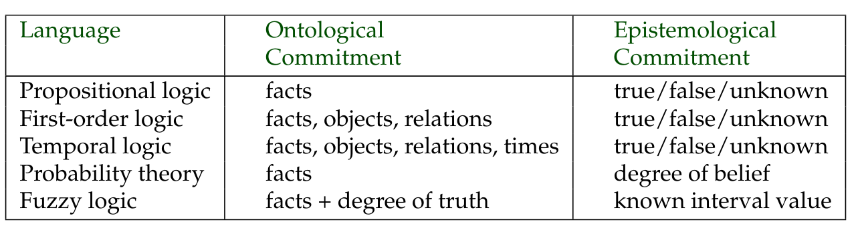
First order logic
definition
Higher-order logic: relations and functions operate not only on objects, but also on relations and functions

Slide 6
First order logic
predicates
In traditional grammar, a predicate is one of the two main parts of a sentence the other being the subject, which the predicate modifies.
  E.g: "John is yellow" John acts as the subject, and is yellow acts as the predicate.
  The predicate is much like a verb phrase.
  In linguistic semantics a predicate is an expression that can be true of something
First Order Logic:
  Contain predicates, quantifiers, and variables:
    E.g. Philosopher (a) → Scholar(a)
  Variable range over individual (domain of discourse)

Slide 7
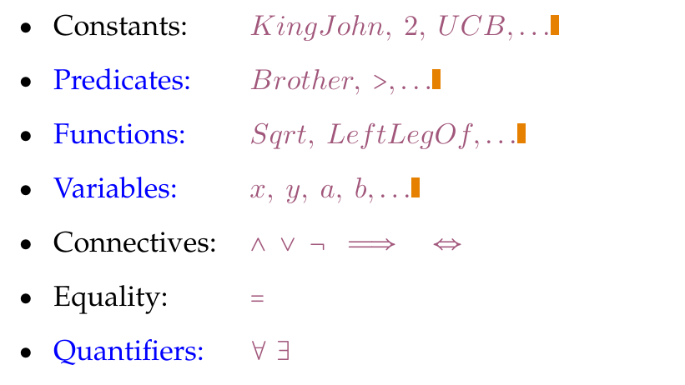
Syntax & semantic
Basic elements

Slide 8
Syntax & semantic
Standard logic symbols
∀ = For all ; [e.g : every one, every body, any time, etc]
∃ = There exists ; [e.g : some one, some time, etc]
⇒ = Implication ; [ if … then ….]
⇔ = Equivalent ; biconditional [if … and … only … if …]
¬ = Not ; negation
∨ = OR ; disjunction
∧ = AND ; conjunction

Slide 9
Syntax & semantic
Atomic sentences
Atomic sentence = 𝑝𝑟𝑒𝑑𝑖𝑐𝑎𝑡𝑒(𝑡𝑒𝑟𝑚_1, . . . , 𝑡𝑒𝑟𝑚_𝑛) 𝑜𝑟 𝑡𝑒𝑟𝑚_1 = 𝑡𝑒𝑟𝑚_2
Term = 𝑓𝑢𝑛𝑐𝑡𝑖𝑜𝑛(𝑡𝑒𝑟𝑚_1, . . . , 𝑡𝑒𝑟𝑚_𝑛) or constant or variable
  𝐵𝑟𝑜𝑡ℎ𝑒𝑟(𝐾𝑖𝑛𝑔𝐽𝑜ℎ𝑛,𝑅𝑖𝑐ℎ𝑎𝑟𝑑𝑇ℎ𝑒𝐿𝑖𝑜𝑛ℎ𝑒𝑎𝑟𝑡) > (𝐿𝑒𝑛𝑔𝑡ℎ(𝐿𝑒𝑓𝑡𝐿𝑒𝑔𝑂𝑓(𝑅𝑖𝑐ℎ𝑎𝑟𝑑)), 𝐿𝑒𝑛𝑔𝑡ℎ(𝐿𝑒𝑓𝑡𝐿𝑒𝑔𝑂𝑓(𝐾𝑖𝑛𝑔𝐽𝑜ℎ𝑛)))

Slide 10
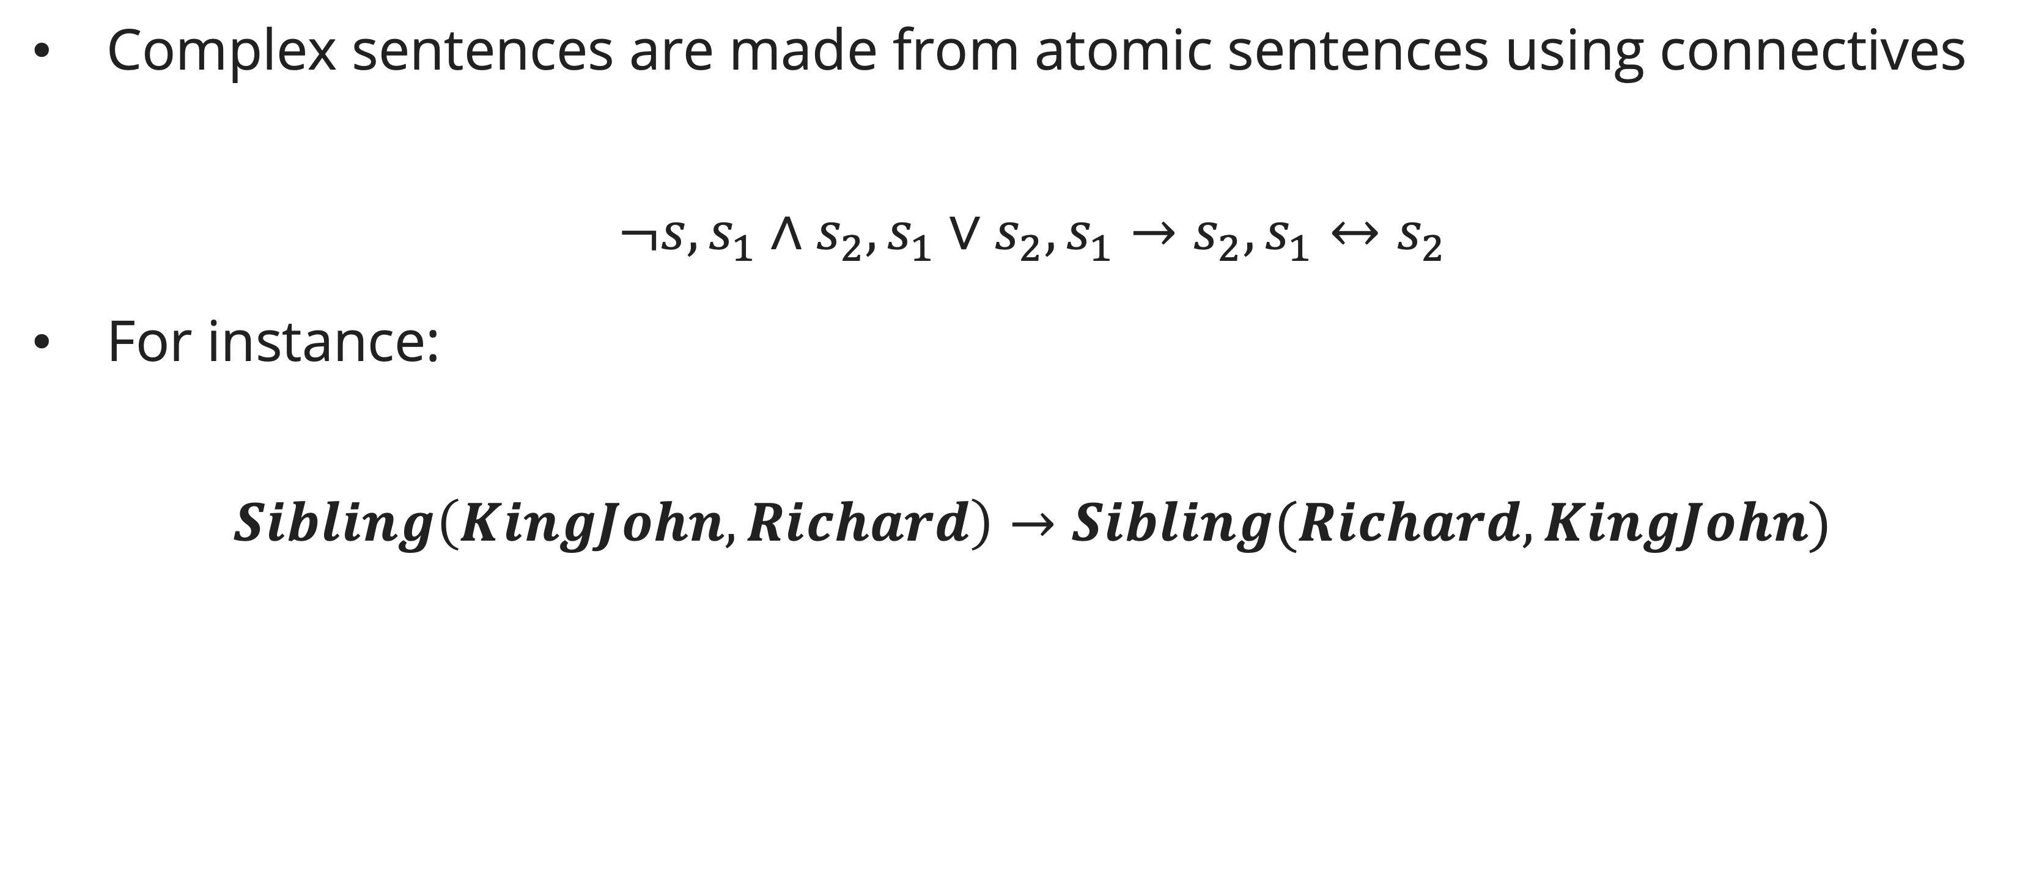
Syntax & semantic
complex sentences
Complex sentences are made from atomic sentences using connectives
$$¬s, s_{1}∧s_{2}, s_{1}∨s_{2}, s_{1}→s_{2},s_{1}↔s_{2}$$
For instance:
$$Sibling\left(KingJohn, Richard\right)→Sibling(Richard, KingJohn)$$

Slide 11
Syntax & semantic
Truth in first order logic
Sentences are true with respect to a model and an interpretation
Model contains ≥ 1 objects (domain elements) and relations among them
Interpretation specifies referents for
  constant symbols → objects
  predicate symbols → relations
  function symbols → functional relations
An atomic sentence predicate(𝑡𝑒𝑟𝑚_1, . . . , 𝑡𝑒𝑟𝑚_𝑛) is true if the objects referred to by (𝑡𝑒𝑟𝑚_1, . . . , 𝑡𝑒𝑟𝑚_𝑛) are in the relation referred to by predicate

Slide 12
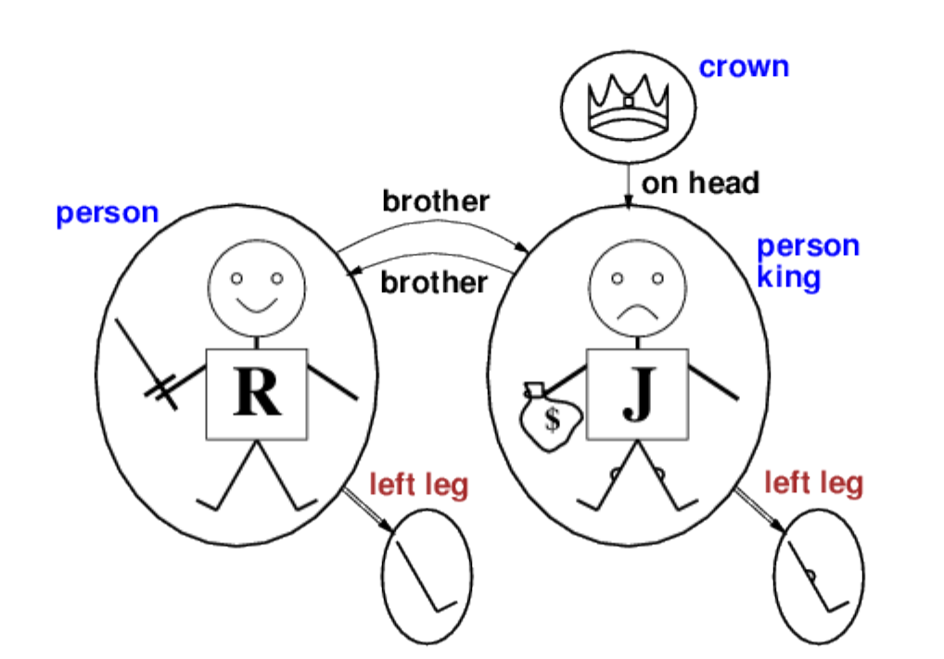
Syntax & semantic
Model of first order logic

Slide 13
Syntax & semantic
Universal quantifier
Sentence: All Kings are persons
Variable x = {Richard, King John, the crown}
FOL: ∀x King(x) → Person(x)
  Richard is a King → Richard is a person
  King John is a King → King John is a person
  The crown is a King → the crown is a person
Attention! Don’t use ∧ for ∀

Slide 14
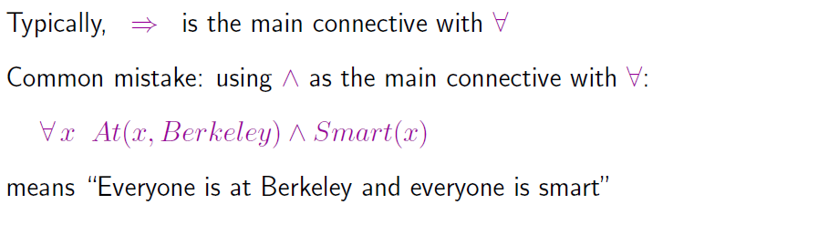
Syntax & semantic
Universal quantifier

Slide 15
Syntax & semantic
existential quantifier
Sentence: The King John has a crown on his head
Variable x = {Richard, King John, the crown}
FOL: ∃x Crown(x) ∧ OnHead(x, John)
  ∃x is pronounced “There exists an x such that …” or “For some x …”
  ∃x P says that P is true in at least one extended interpretation that assigns x to a domain element

Slide 16
Syntax & semantic
existential quantifier
Sentence: The King John has a crown on his head
Variable x = {Richard, King John, the crown}
FOL: ∃x Crown(x) ∧ OnHead(x, John)
  Richard is a Crown ∧ Richard is on John’s head
  King John is a Crown ∧ King John is on John’s head
  The crown is a Crown ∧ the crown is on John’s head (True) then the sentence is true, at least one

Slide 17
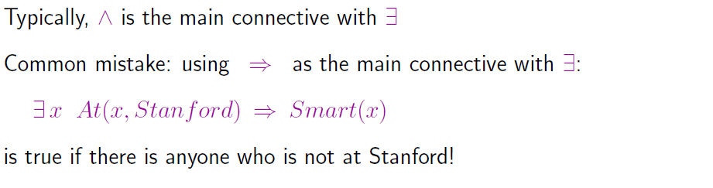
Syntax & semantic
existential quantifier

Slide 18
Syntax & semantic
nested quantifier
Sentence: Brothers are siblings
  ∀x ∀y Brother(x, y) ⇒ Sibling(x, y)
Consecutive quantifiers of the same type can be written as one quantifier with several variables
To say that siblinghood is a symmetric relationship:
  ∀ x,y Sibling(x,y) ⇔ Sibling(y,x)

Slide 19
Syntax & semantic
nested quantifier
A mixture:
  “Everybody loves somebody”:
    ∀x ∃y Loves(x, y)
  “There is someone who is loved by everyone” :
    ∃y ∀x Loves(x, y)
What about…
  ∃x ∀ y Loves(x, y)?
  ∀ y ∃x Loves(x, y)?

Slide 20
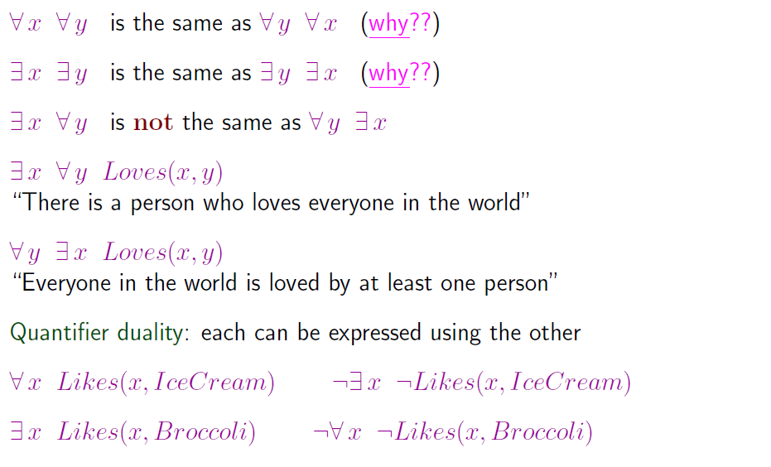
Syntax & semantic
nested quantifier

Slide 21
Inference first order logic
Rule of Inference
We begin with some simple inference rules (Instantiation) that can be applied to sentences with quantifiers to obtain sentences without quantifiers.
These rules lead naturally to the idea that first-order inference can be done by converting the knowledge base to propositional logic and using propositional inference

Slide 22
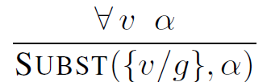
Inference first order logic
Universal instantiation
For any variable v and ground term g,
Axiom that all greedy king are evil :
  e.g., ∀x King(x) ∧ Greedy(x) ⇒ Evil(x) yields:
    King(John) ∧ Greedy(John) ⇒ Evil(John)
    King(Richard) ∧ Greedy(Richard) ⇒ Evil(Richard)
    King(Father(John)) ∧ Greedy(Father(John)) ⇒ Evil(Father(John))

Slide 23
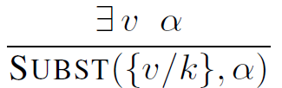
Inference first order logic
existential instantiation
For any sentence α, variable v, and constant symbol k that does not appear elsewhere in the knowledge base:
e.g., ∃x: Crown (x) ∧ OnHead (x, John) yields:
  Crown (C₁) ∧ OnHead (C₁, John)
  provided C₁ is a new constant symbol, called a Skolem constant

Slide 24
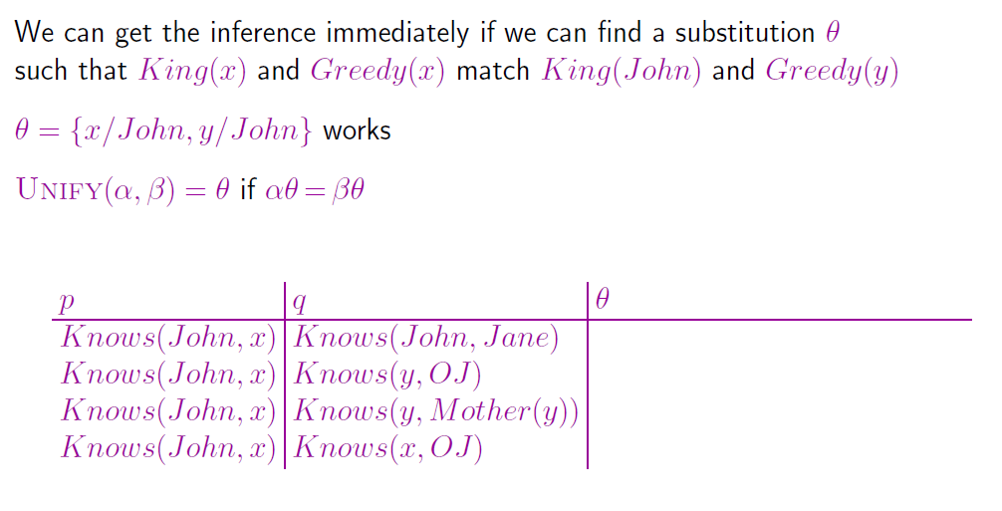
Inference first order logic
unification

Slide 25
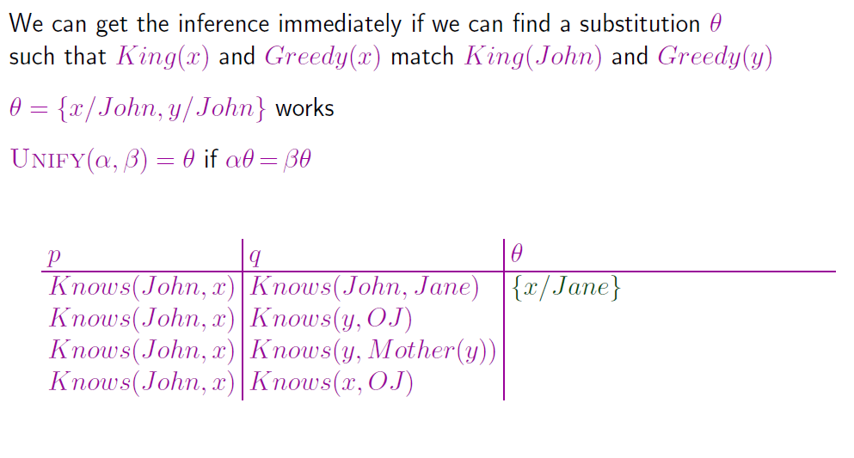
Inference first order logic
unification

Slide 26
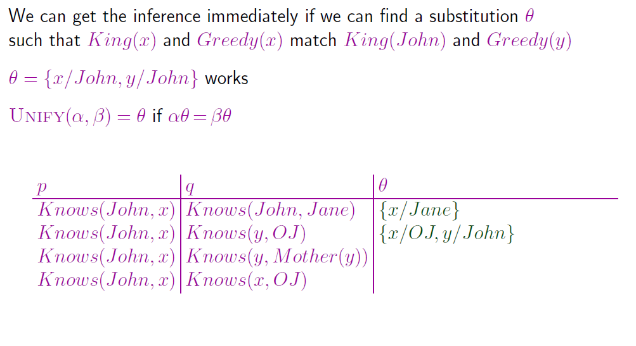
Inference first order logic
unification

Slide 27
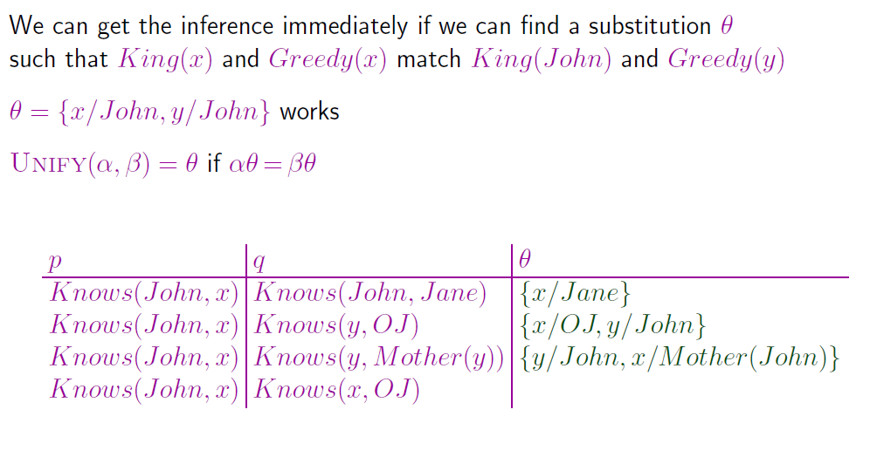
Inference first order logic
unification

Slide 28
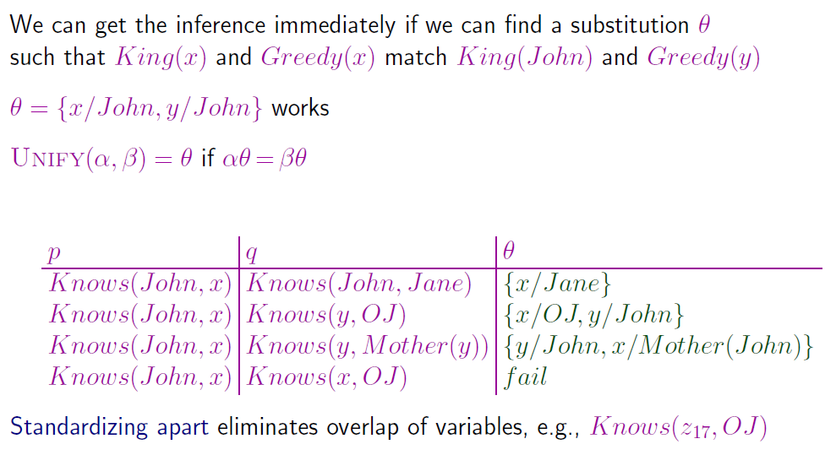
Inference first order logic
unification

Slide 29
Inference first order logic
unification
To unify Knows (John, x) and Knows (y, z), could return:
  θ = {y/John, x/z} or θ = {y/John, x/John, z/John}
The first unifier is more general than the second.
There is a single most general unifier (MGU) that is unique up to renaming of variables.
  MGU = { y/John, x/z }

Slide 30
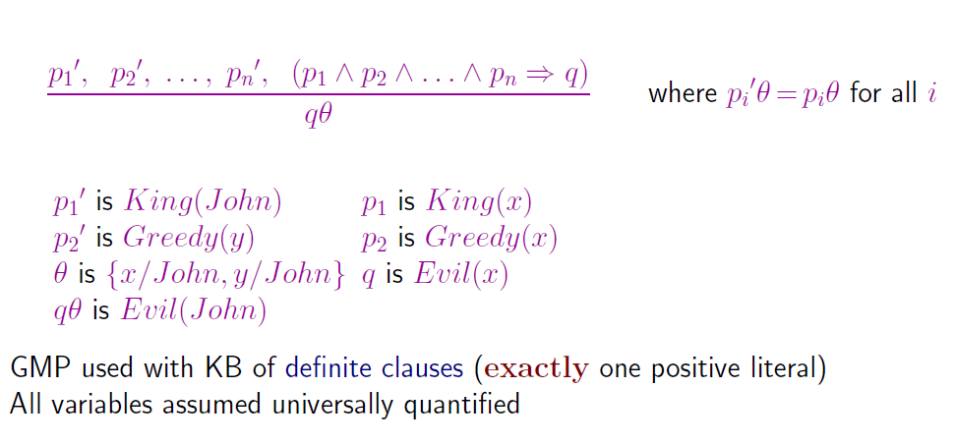
Inference first order logic
Generalization Modus ponen

Slide 31
Inference first order logic
Generalization Modus ponen
The law says that it is a crime for an American to sell weapons to hostile nations. The country Nono, an enemy of America, has some missiles, and all of its missiles were sold to it by Colonel West, who is American.
Prove that Colonel West is a criminal

Slide 32
Inference first order logic
Generalization Modus ponen
... it is a crime for an American to sell weapons to hostile nations:
  American(x) ∧ Weapon(y) ∧ Sells(x, y, z) ∧ Hostile(z) ⇒ Criminal(x)
Nono … has some missiles, i.e., ∃x Owns(Nono, x) ∧ Missile(x):
  Owns(Nono,M₁)
  Missile(M₁)
… all of its missiles were sold to it by Colonel West
  Missile(x) ∧ Owns(Nono, x) ⇒ Sells(West,x,Nono)

Slide 33
Inference first order logic
Generalization Modus ponen
Missiles are weapons:
  Missile(x) → Weapon(x)
An enemy of America counts as "hostile“:
  Enemy(x, America) → Hostile(x)
West, who is American …
  American(West)
The country Nono, an enemy of America …
  Enemy(Nono, America)

Slide 34
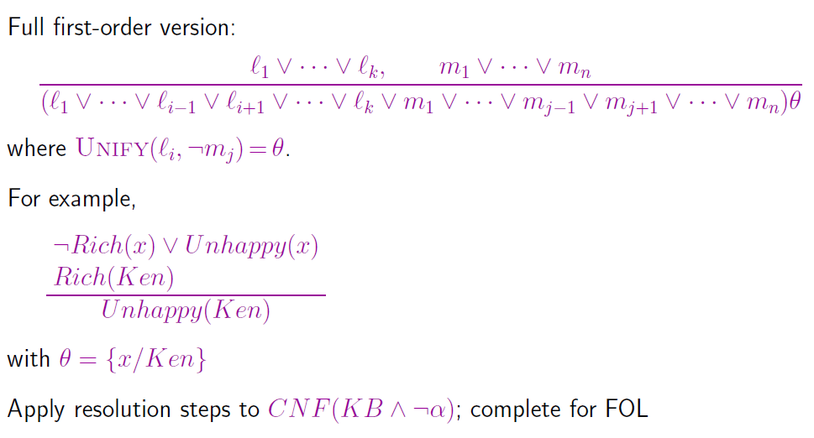
Inference first order logic
Resolution

Slide 35
Conversion to CNF
Conjunctive normal form
In Boolean logic, a formula is in conjunctive normal form (CNF) or clausal normal form if it is a conjunction of one or more clauses, where a clause is a disjunction of literals.
Otherwise put, it is a product of sums or an AND of ORs.
In first order logic, conjunctive normal form can be used to perform first-order resolution.

Slide 36

Conversion to CNF
Conjunctive normal form example
All of the following formulas are in conjunctive normal form:
  $(B∨C)∧(D∨E∨F)$
  $(B∨C)∧(D)$
  $(B∨C)$
  $(A)$

Slide 37

Conversion to CNF
Conjunctive normal form example
All of the following formulas are not in conjunctive normal form:
  $¬\left(B∧C\right)$, since an AND is nested within a NOT
  $¬(B∨C)∧(D)$, since an OR is nested within a NOT
  $A∧(B∨\left(E∧C\right))$, since an AND is nested within an OR

Slide 38
Conversion to CNF
example
Sentence : “Everyone who loves all animals is loved by someone”:
∀x [∀y Animal(y) ⇒ Loves(x, y)] ⇒ [∃y Loves(y, x)]
Eliminate implications
  ∀x [¬∀y ¬Animal(y) ∨ Loves(x, y)] ∨ [∃y Loves(y, x)]
Move ¬ inwards:
  ¬∀x p ≡ ∃x ¬p, ¬ ∃x p ≡ ∀x ¬p
  ∀x [∃y ¬(¬Animal(y) ∨ Loves(x, y))] ∨ [∃y Loves(y, x)]
  ∀x [∃y ¬¬Animal(y) ∧ ¬Loves(x, y)] ∨ [∃y Loves(y, x)]
  ∀x [∃y Animal(y) ∧ ¬Loves(x, y)] ∨ [∃y Loves(y, x)]

Slide 39
Conversion to CNF
example
Standardize variables: each quantifier should use a different one
    ∀x [∃y Animal(y) ∧ ¬Loves(x, y)] ∨ [∃z Loves(z, x)]
Skolemize: a more general form of existential instantiation. Each existential variable is replaced by a Skolem function of the enclosing universally quantified variables:
    ∀x [Animal(F(x)) ∧ ¬Loves(x, F(x))] ∨ Loves(G(x),x)
Drop universal quantifiers:
    [Animal(F(x)) ∧ ¬Loves(x,F(x))] ∨ Loves(G(x),x)
Distribute ∨ over ∧ :
    [Animal(F(x)) ∨ Loves(G(x),x)] ∧ [¬Loves(x, F(x)) ∨ Loves(G(x), x)]

Slide 40
Conversion to CNF
example
American(x) ∧ Weapon(y) ∧ Sells(x, y, z) ∧ Hostile(z) ⇒ Criminal(x)
  ¬American(x) ∨ ¬Weapon(y) ∨ ¬Sells(x, y, z) ∨ ¬Hostile(z) ∨ Criminal(x)
Owns(Nono,M₁) and Missile(M₁)
  Owns (Nono, M1)
  Missile(M1)
Missile(x) ∧ Owns(Nono, x) ⇒ Sells(West, x, Nono)
  ¬Missile(x) ∨ ¬Owns(Nono, x) ∨ Sells(West, x, Nono)

Slide 41
Conversion to CNF
example
Missile(x) ⇒ Weapon(x)
  ¬Missile(x) ∨ Weapons(x)
Enemy(x, America) ⇒ Hostile(x)
  ¬Enemy(x, America) ∨ Hostile(x)
American(West)
  American(West)
Enemy(Nono, America)
  Enemy(Nono, America)

Slide 42
Conversion to CNF
example
Knowledge Base in CNF
  ¬American(x) ∨ ¬Weapon(y) ∨ ¬Sells(x, y, z) ∨ ¬Hostile(z) ∨ Criminal(x)
  ¬Missile(x) ∨ ¬Owns(Nono, x) ∨ Sells(West, x, Nono)
  ¬Enemy(x, America) ∨ Hostile(x)
  ¬Missile(x) ∨ Weapons(x)
  Owns (Nono, M1)
  Missile(M1)
  American(West)
  Enemy(Nono, America)

Slide 43
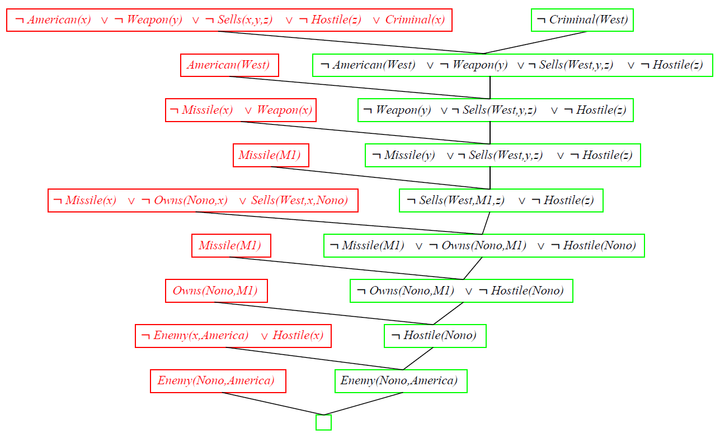
Conversion to CNF
resolution

Slide 44
Case study
Proof by resolution
Given sentences as premise:
John is a student
John is in the Informatics department
Each Informatics’ student must be an engineering student
Mathematic is a difficult lesson
Each engineering student would definitely like Mathematic or hate it
Each student would definitely like a lesson
Students who have never attended difficult lesson certainly do not like the lesson
Peter has never attended the Mathematic lesson

Slide 45
Case study
Proof by resolution
Based on given premises above, please create:
FOL
Convert FOL in part a) to CNF
Proof by Resolution, that Peter hate Mathematic.

Slide 46
References
Session 8
Rosen, K. H. (2012). Discrete mathematics and its applications (7th ed). McGraw-Hill.
Russell, S. J., Norvig, P., Chang, M., Devlin, J., Dragan, A., Forsyth, D., Goodfellow, I., Malik, J., Mansinghka, V., Pearl, J., & Wooldridge, M. J. (2022). Artificial intelligence: A modern approach (Fourth edition, global edition). Pearson.
https://www.cs.jhu.edu/~phi/ai/slides/lecture-first-order-logic.pdf

